Slide 1
Exploring Electric Vehicle Adoption Trends in Washington State
Student Name: Arunkumar Cherungot-Meppadathkalam
Student No.: 501277792
Github Repository: https://github.com/acherungotTMU/TMU_Capstone
Supervisor: Tamer Abdou
Date of Submission: 22nd July 2024

Slide 2
Data Information
Dataset Link: https://catalog.data.gov/dataset/electric-vehicle-population-data
License Information: https://opendatacommons.org/licenses/odbl/1-0/
The dataset utilized in this study comprises registered Battery Electric Vehicles (BEVs) and Plug-in Hybrid Electric Vehicles (PHEVs) through the Washington State Department of Licensing (DOL). The dataset has more than 180000 observations and includes detailed information on vehicle types, ownership demographics, geographic distribution and additional attributes such as vehicle make, model, year, and electric range.
VIN (1-10), County, City, State, Postal Code, Model Year, Make, Model, Electric Vehicle Type, CAFV Eligibility, Electric Range, Base MSRP, Legislative District, DOL Vehicle ID, Vehicle Location, Electric Utility and 2020 Census Tract are the dataset variables
Project Objective
Understand factors influencing EV adoption and predict future trends in Washington State.

Slide 3
Research Question No.1
Based on data collected from 2015 to 2023, which covers approximately 5% of Washington State's population, what are the primary factors influencing the decision to purchase BEVs and PHEVs in the state?
Objective
Apply machine learning models to identify the primary factors influencing the decision to purchase BEVs and PHEVs in Washington State.

Slide 4
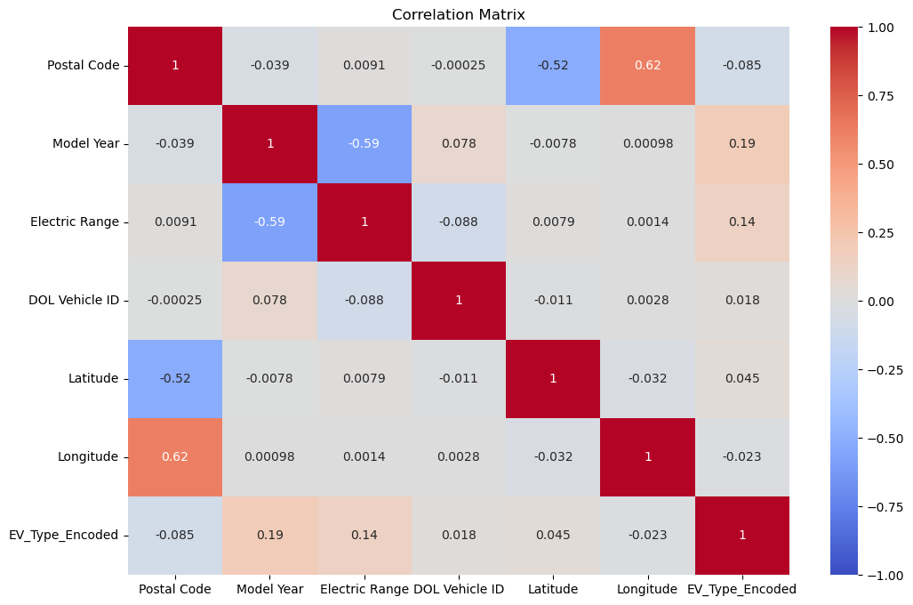
Methodology
Data Preprocessing:
Cleaning the data
Removing Outliers
Feature encoding
Correlation Analysis:
Using correlation to understand the dataset's structure and relationships with Electric Vehicle Type.
Key Findings:
Model Year has the highest positive correlation (0.189591) with the target variable. This suggests that newer model years are somewhat associated with BEVs compared to PHEVs.
Electric Range also has a moderate positive correlation (0.143539), indicating that BEVs might have a higher electric range compared to PHEVs.
Postal Code, DOL Vehicle ID, Latitude, and Longitude show very weak correlations with the target variable.

Slide 5
Methodology (contd.)
Feature Importance and Selection:
RandomForest: Determined the significant features using random forest model
Recursive Feature Elimination (RFE): Identified the top features using Logistic Regression
Key Findings: Electric Range, CAFV Eligibility, Make (eg. Tesla, Toyota, BMW, Nissan), Model Year were the top features identified
Top features by Random Forest:
Feature | Importance
Electric Range | 0.1945
Clean Alternative Fuel Vehicle (CAFV) Eligibility_Not elegible due to low battery range | 0.106242
Clean Alternative Fuel Vehicle (CAFV) Eligibility unknown as battery range has not been researched | 0.081302
Make_TESLA | 0.059041
Model Year | 0.049786
Clean Alternative Fuel Vehicle (CAFV) Eligibility_Clean Alternative Fuel Vehicle Eligibility | 0.035982
Model_VOLT | 0.033117
Make_TOYOTA | 0.032135
Make_CHRYSLER | 0.022602
Make_BMW | 0.020247
Make_JEEP | 0.019935
Model_PACIFICA | 0.01951
Model_X5 | 0.016716
Model_MODEL 3 | 0.016316
Model_PRIUS PRIME | 0.014884
DOL Vehicle ID | 0.014242
Model_RAV4 PRIME | 0.013485
Model_WRANGLER | 0.013039
Model_LEAF | 0.012394
Model_BOLT EV | 0.011453
Top Features by RFE (Logistic Regression)
Feature | Ranking
Electric Range | 1
Postal Code | 1
Latitude | 1
Make_NISSAN | 1
Model_MODEL Y | 1
Model_LEAF | 1
Model_WRANGLER | 1
DOL Vehicle ID | 1
Model_MODEL 3 | 1
Model_PACIFICA | 1
Model_PRIUS PRIME | 1
Make_BMW | 1
Clean Alternative Fuel Vehicle (CAFV) Eligibility_Not eligible due to low battery range | 1
Make_CHRYSLER | 1
Clean Alternative Fuel Vehicle (CAFV) Eligibility unknown as battery range has not been researched | 1
Make_TOYOTA | 1
Model_VOLT | 1
Make_JEEP | 1
Model Year | 1
Make_TESLA | 1

Slide 6
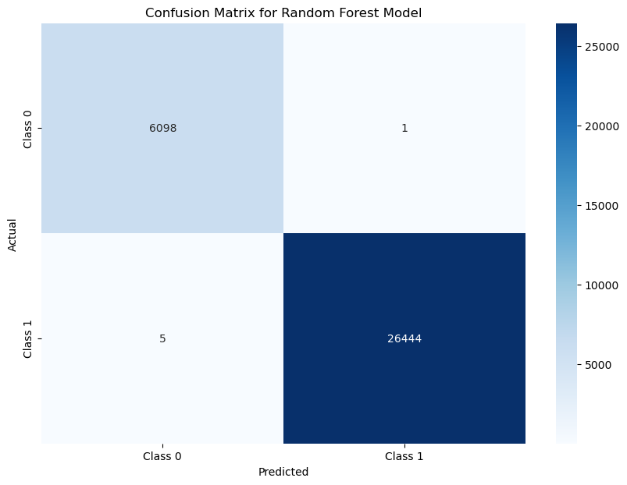
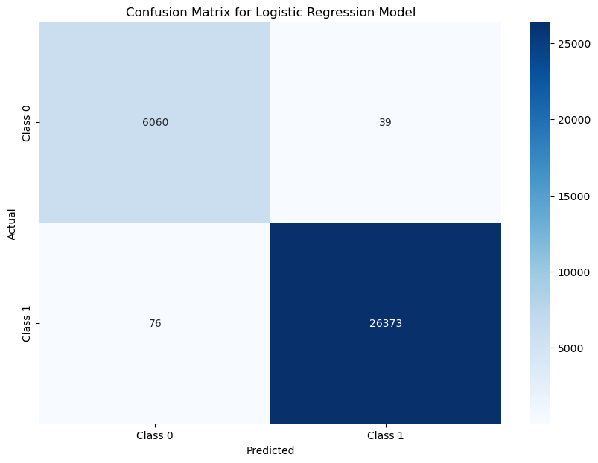
Methodology (contd.)
Model Performance Evaluation:
Models Used:
Random Forest
RFE using Logistic Regression
Performance Metrics:
Random Forest:
Class BEV correctly predicted: 26444
Class PHEV correctly predicted: 6098
Class BEV incorrectly predicted as Class PHEV: 1
Class PHEV incorrectly predicted as Class BEV: 5
Logistic Regression (RFE):
Class BEV correctly predicted: 26373
Class PHEV correctly predicted: 6060
Class BEV incorrectly predicted as Class PHEV: 39
Class PHEV incorrectly predicted as Class BEV: 76

Slide 7
Findings and Insights
Key Factors Influencing EV Adoption: Electric Range, Clean Alternative Fuel Vehicle Eligibility, Make (TESLA, NISSAN), Model Year, Geographic Factors.
Interpretation:
Strong preference for vehicles with higher electric range.
Eligibility for clean alternative fuel vehicles significantly impacts adoption.
Newer models were more favored
Geographic variables like postal code and legislative district were less influential.

Slide 8
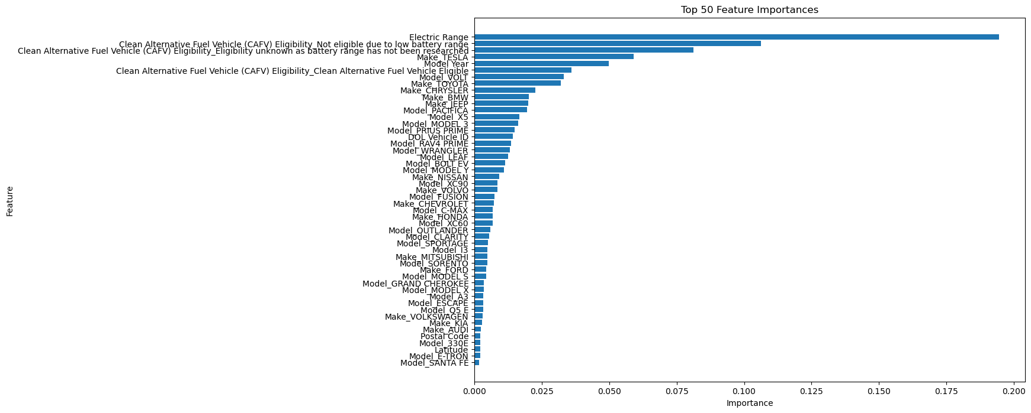
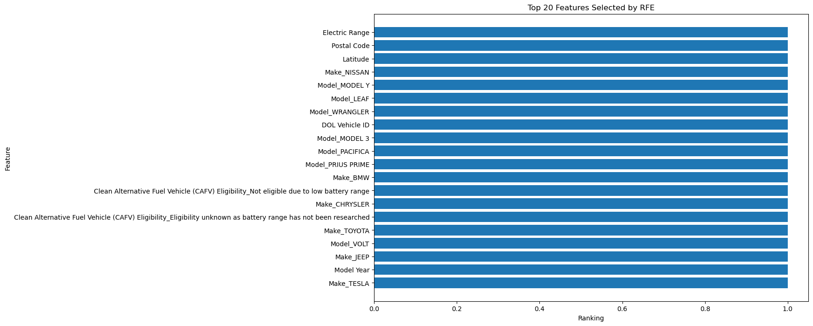
Top Features using Random Forest
Top Features using RFE (Logistic Regression)

Slide 9
Conclusion
Summary of Findings:
Identified key factors influencing EV adoption.
High model accuracy and robust predictions.
Practical Implications:
Inform policymakers and marketers to promote EV adoption.
Insights for automotive industry stakeholders.
Limitations
Dataset covers only 5% of Washington State's population.
Unavailability of external factors like economic incentives, demographic factors and infrastructure.

Slide 10
Research Question No.2
Can we use machine learning to predict the number of new electric vehicle adopters over the next ten years in Washington State, based on detailed data about residents' geographic locations and the availability of infrastructural facilities, such as electric utility stations?
Objective
Utilize machine learning models to forecast future adoption rates of electric vehicles based on geographic and infrastructural data, enabling stakeholders to prepare for the anticipated increase in electric vehicle numbers.

Slide 11
Methodology
Data Preprocessing:
Cleaning the data
Removing Outliers
Feature engineering
Normalizing numerical features
Machine Learning Models:
Linear Regression: Captures relationship between geographic infrastructural data and EV adoption rates.
Random Forest: Captures complex non-linear relationships between variables
Training and Testing:
Data split: 80% training, 20% testing.
Evaluation metrics: Mean Squared Error (MSE) and R-squared (R²).

Slide 12
Findings and Insights
Model Comparison:
Linear Regression: Faster training and prediction times, with moderate R² values. Linear Regression model might have limitations in accuracy and generalizability, it does a better job of reflecting expected changes over time compared to the Random Forest model.
Random Forest: High training R² and testing R², but struggles with static predictions indicating that the Random Forest models are not inherently designed to handle time-series data.

Slide 13
Findings and Insights (Contd.)
Predicted Results using Linear Regression:
Using Linear Regression, predictions were made for the number of BEVs and PHEVs that will be registered over the next 10 years on a county-wise, city-wise, and electric utility-wise basis.
County-wise electric vehicle prediction for the next 10 years using Linear Regression (10 observations)

Slide 14
Findings and Insights (Contd.)
City-wise electric vehicle prediction for the next 10 years using Linear Regression (20 observations)
Utility-wise electric vehicle prediction for the next 10 years using Linear Regression (10 observations)

Slide 15
Findings and Insights (Contd.)
Predicted Results using Random Forest:
Predictions using Random forest were static over the years indicating that the model has some limitations in predicting future data.
County-wise electric vehicle prediction for the next 10 years using Random Forest (10 observations)

Slide 16
Findings and Insights (Contd.)
City-wise electric vehicle prediction for the next 10 years using Random Forest (20 observations)
Utility-wise electric vehicle prediction for the next 10 years using Random Forest (10 observations)

Slide 17
Conclusion
Machine learning can predict future EV adoption in Washington State based on detailed data about residents' geographic locations and the availability of infrastructural facilities..
The choice of the machine learning model is crucial as in this case Linear Regression emerged as the most effective model for this prediction task.
Limitations
Need for additional features like income levels, fuel prices, and government incentives to improve predictive performance.
Random Forest's limitations in capturing temporal trends highlight the need for advanced time-series models.
Importance of continuous data collection for ongoing model improvement.

Slide 18
Research Question No.3
How do geographic location and local infrastructure (electric utilities) impact EV adoption in Washington?
Objective
To understand the influence of geographic and infrastructural factors on EV adoption in Washington State.
To provide insights that can guide policy and infrastructure development to enhance EV adoption.

Slide 19
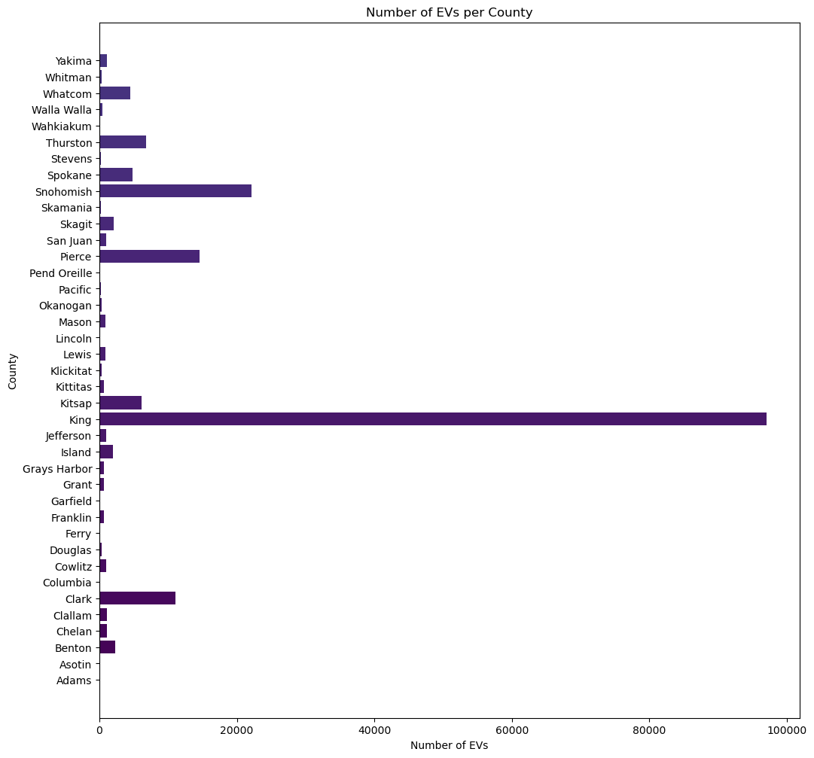
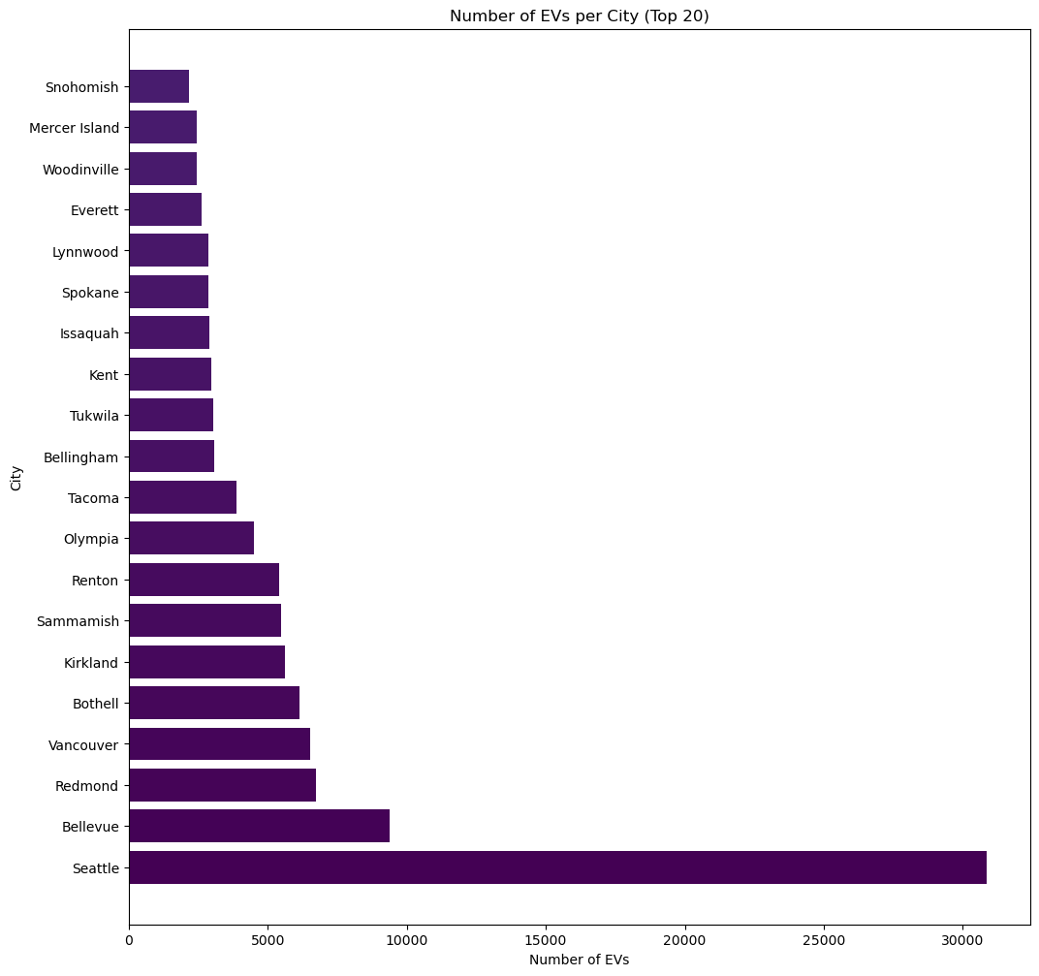
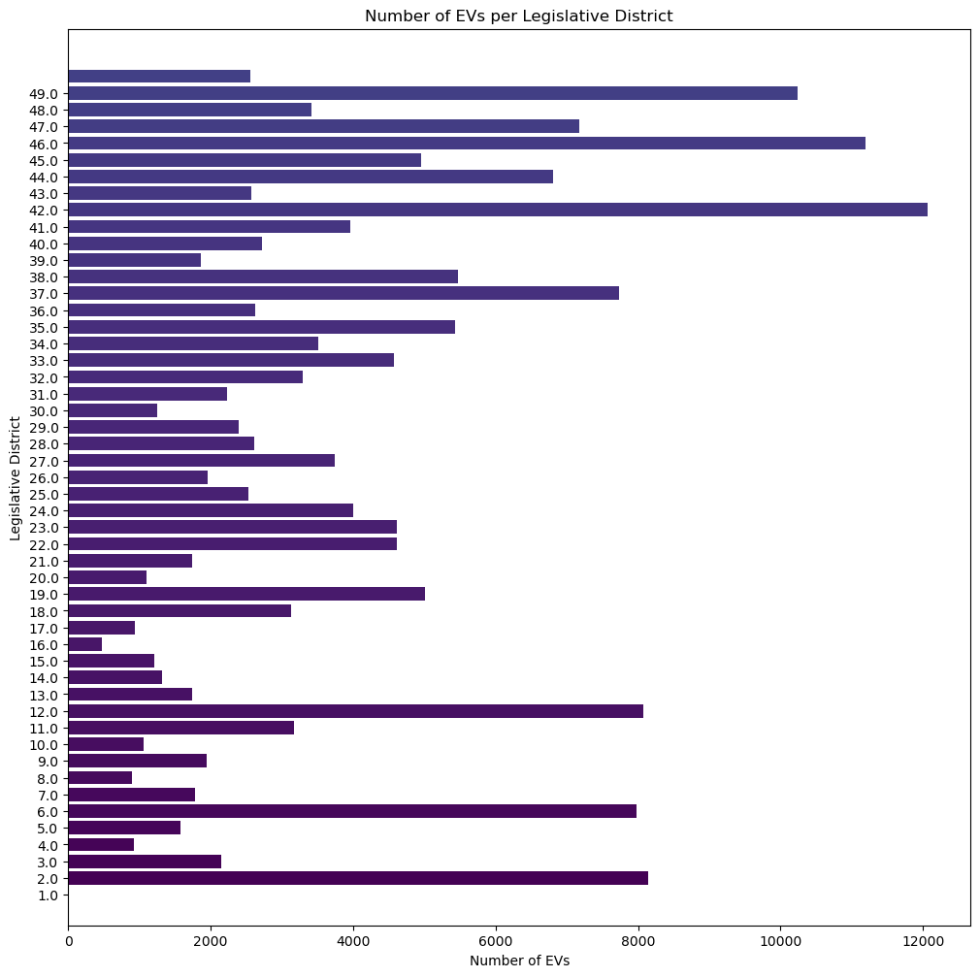
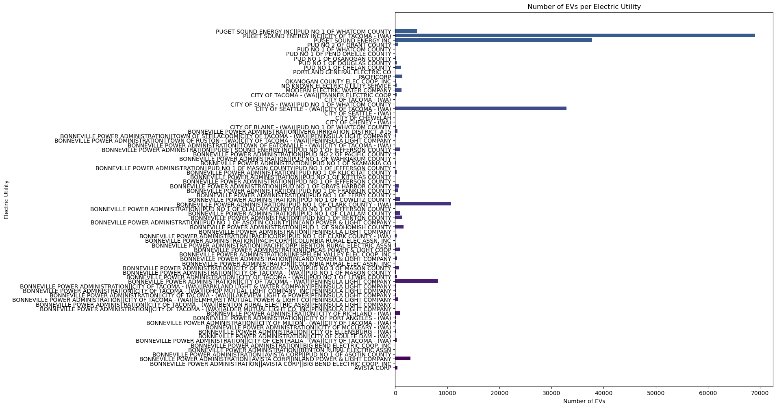
Methodology
Data Collection and Preprocessing:
Dataset: EV registrations in Washington State
Cleaning the data
Removing Outliers
Feature encoding
Feature Engineering:
Created new features representing the number of EVs per county, city, legislative district, and electric utility.
Used GeoPandas for geographic validation and spatial distribution visualization.

Slide 20
Methodology (Contd.)
Multiple Linear Regression Analysis:
Developed OLS regression models to assess the impact of geographic and infrastructural variables on EV adoption.
Clustering Analysis:
Applied K-Means clustering to identify patterns and group similar areas based on EV adoption rates.
Generated cluster profiles to summarize characteristics of each cluster.
Association Rule Analysis:
Used the Apriori algorithm to find associations between geographic/infrastructural variables and EV adoption.

Slide 21
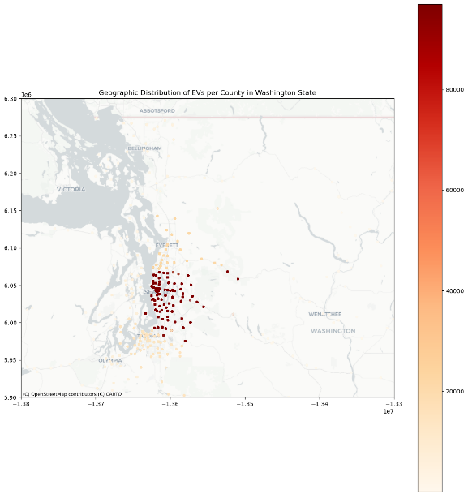
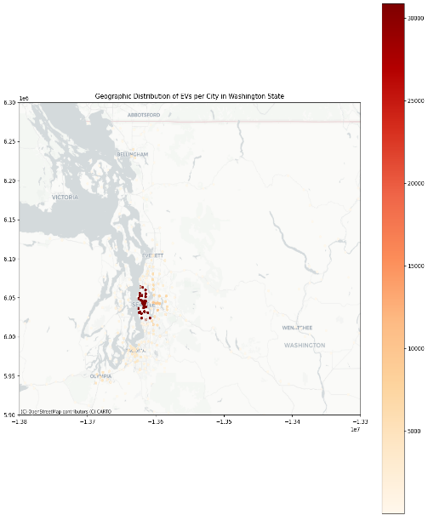
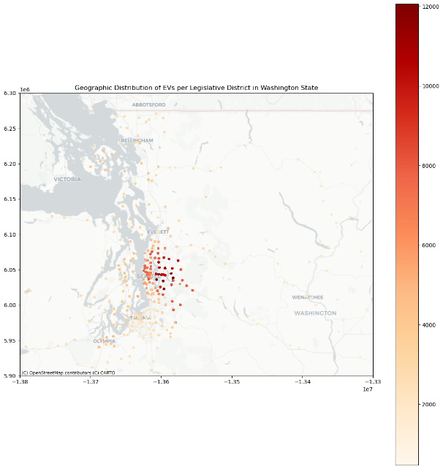
Findings and Insights
Geographic Distribution:
King County, Seattle, and Bellevue lead in EV adoption.
Higher concentration of EVs in urban and economically developed areas.
Density and Distribution of EV adoption across different latitudes and longitudes
Geographic distribution of EVs per county Geographic distribution of EVs per city
Geographic distribution of EVs Legislative District

Slide 22
Findings and Insights (Contd.)
Regression Analysis:
OLS regression models show high R-squared values, indicating a strong relationship between geographic/infrastructural variables and EV counts.

Slide 23
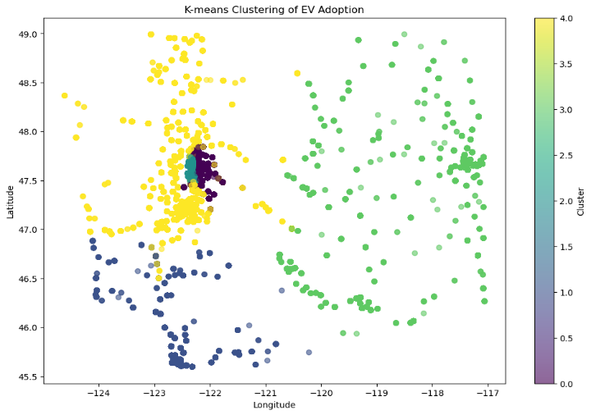
Findings and Insights (Contd.)
Clustering Analysis:
K-Means clustering identified distinct groups of areas with similar EV adoption patterns, highlighting the influence of geographic location and infrastructure on EV adoption.
Cluster Profile providing a summary of characteristics of different features through K-Means clustering
Scatterplot of K-means clustering of EV adoption

Slide 24
Findings and Insights (Contd.)
Association Rule Analysis:
Apriori algorithm finds significant associations between geographic/infrastructural variables and EV adoption.
First 20 results of the association rules data frame

Slide 25
Conclusion
Geographic location and local infrastructure significantly impact EV adoption in Washington.
Areas with higher population density and better infrastructural support have higher EV adoption rates.
Efficient and extensive electric utilities further facilitate EV adoption.
Targeted policies and infrastructure development in underrepresented areas can enhance EV adoption.
Limitations
The study is limited to Washington State, and results may not be generalizable to other regions.
Data covers only 5% of Washington state. More data can help in improving the analysis of geographical and infrastructural features.

Slide 26
This study provides valuable insights into the factors influencing EV adoption and predict future trends in Washington State. I hope these findings will contribute to the development of targeted policies and infrastructure improvements that promote sustainable transportation and increase EV adoption. I would be happy to address any questions or provide further details. Thank You.

